Slide 1
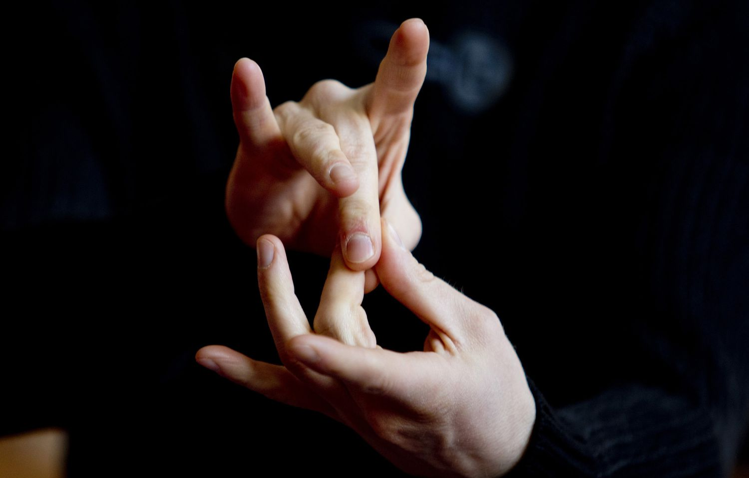

Slide 3
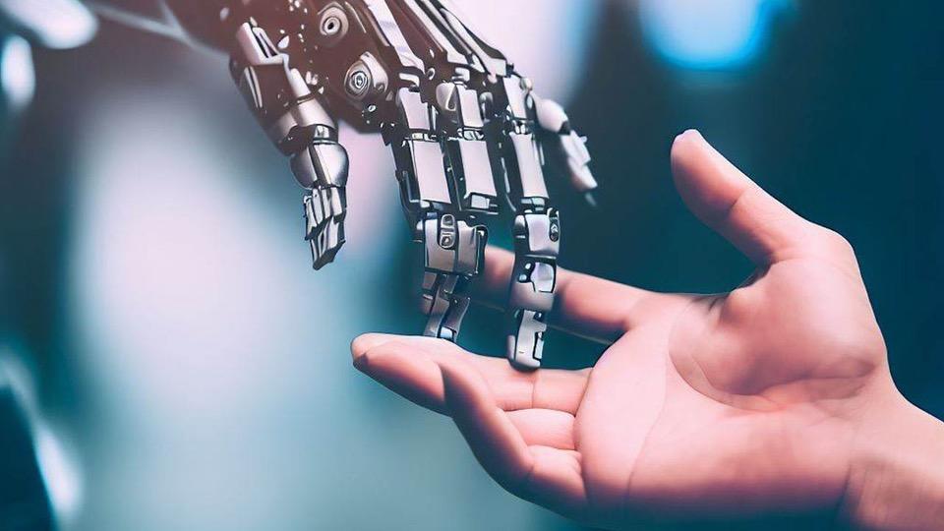
Project Description
Objective:
Using machine learning techniques, create a reliable system that can recognize sign language motions in real time.
Problem Statement: Developing a system that reliably converts sign language into spoken or written language in order to narrow the communication gap between people with and without hearing difficulties.
Dataset:
The dataset has been taken from Kaggle named ASL alphabet

Slide 4
Solution
Preprocessing:
Apply preprocessing techniques like Gray scale conversion, resizing and data type conversion among other.
Model Selection: Exploring various different model to find the best one for the task
Real-time Recognition:
Establish a system capable of swiftly identifying sign language gestures captured by a webcam or other input devices in real-time.

Slide 5
Technologies Used
Tensorflow
Open-CV
Scikit-learn
The technology used are
Open-source machine learning framework for building and deploying machine learning models.
https://www.tensorflow.org/
Open Source Computer Vision Library, providing tools for computer vision and image processing.
https://opencv.org/
Simple and efficient tools for data mining and data analysis, built on NumPy, SciPy, and Matplotlib.
https://scikit-learn.org/

Slide 6
Keras
Tensorflow
Open-CV
Scikit-learn
High-level neural networks API, enabling easy and fast prototyping of deep learning models.
https://keras.io/
Open-source machine learning framework for building and deploying machine learning models.
https://www.tensorflow.org/
Open Source Computer Vision Library, providing tools for computer vision and image processing.
https://opencv.org/
Simple and efficient tools for data mining and data analysis, built on NumPy, SciPy, and Matplotlib.
https://scikit-learn.org/

Slide 7
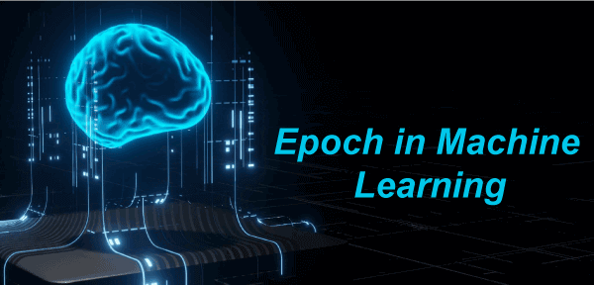
Training Process
An epoch represents one complete pass through the entire training dataset during model training. The model's parameters are adjusted based on the calculated error, aiming to improve predictive performance. The number of epochs is a hyperparameter set by the practitioner, balancing the risk of underfitting and overfitting.

Slide 8
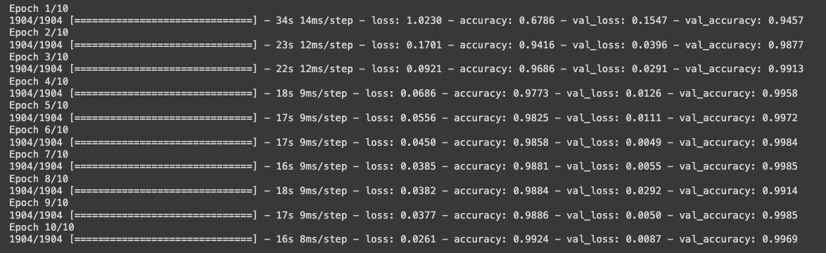
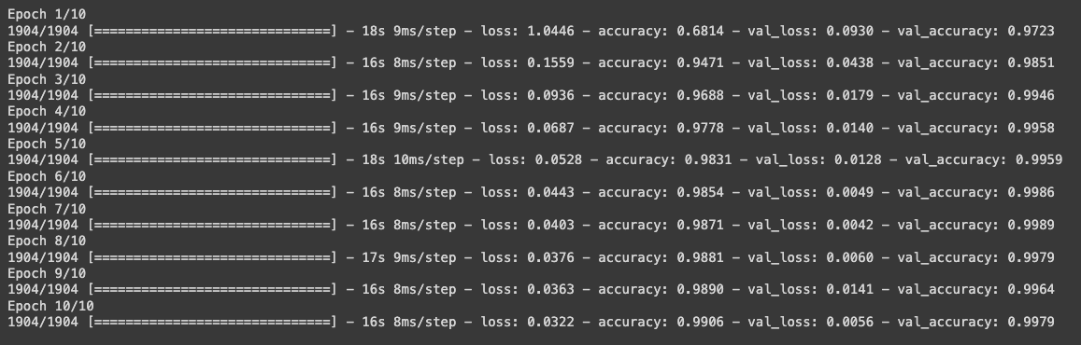
Training Process

Slide 9
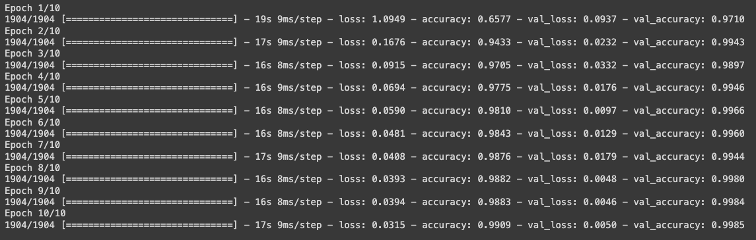
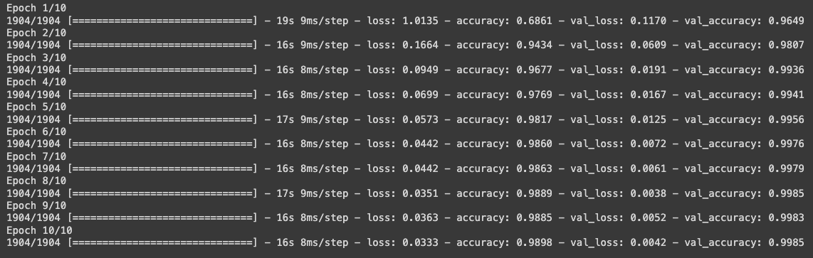
Training Process

Slide 10

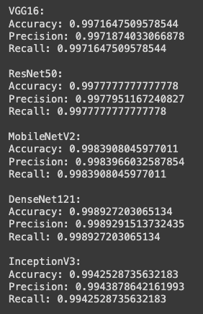
Model Performance

Slide 11
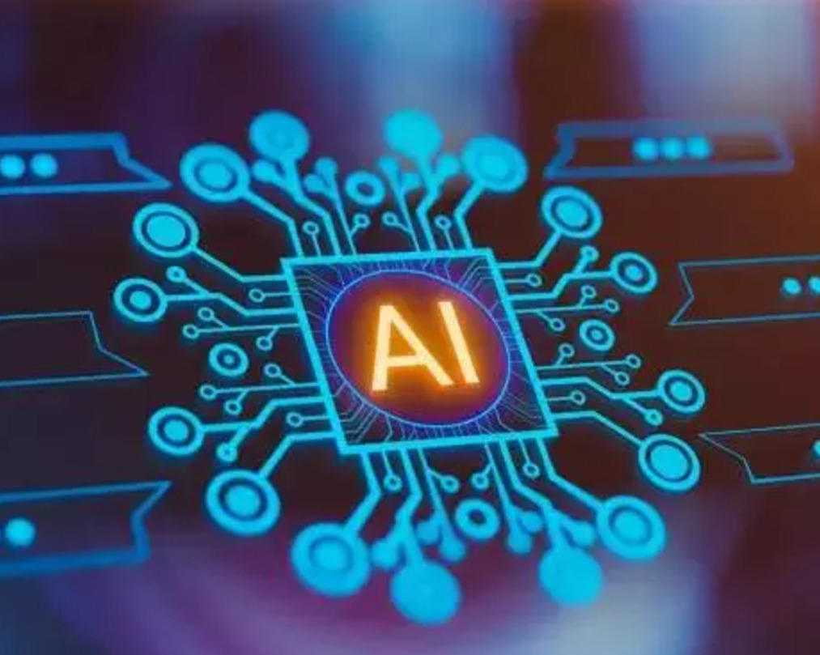
Future Work
Improving the Accuracy of Live Prediction
Implementing the speech function for the written text

Slide 12
Sarthak Chauhan
E22CSEU0056
Yoosha Mirza
E22CSEU0046
Team Details
Model Selection
Model Making
Dataset Selection
Text to Speech
Contribution

Slide 13
Siddhart Patel
E22CSEU0044
Sarthak Chauhan
E22CSEU0056
Yoosha Mirza
E22CSEU0046
Model Selection
Model Making
Model Selection
Model Making
Dataset selection
Model Making

